Slide 1

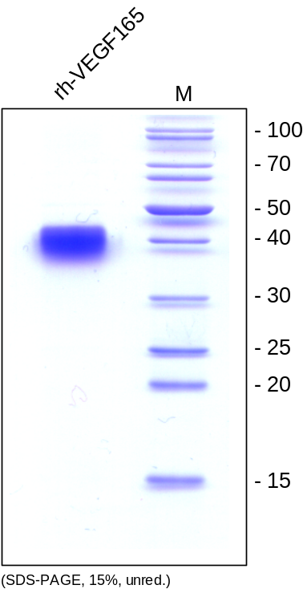
ReliaTech GmbH
Recombinant human VEGF165
(Cat #300-035 / 300-036)
Fig. 1: SDS-PAGE analysis of recombinant human VEGF₁₆₅ produced in insect cells. Sample was loaded in 15% SDS-polyacrylamide gel under non-reducing conditions and stained with Coomassie blue.
http://www.reliatech.de / orders@reliatech.de

